Slide 1

SHYAM STEEL
BUSINESS INSIGHTS
Presentation by
Taj Hasan Mansuri

Slide 2

Retail Sales Insights of the comapny
By leveraging these insights, Shyam Steel can make data-driven decisions, align their business strategies with market demands, enhance customer experiences, and drive business growth in the highly competitive industry.

Slide 3

Feature Importance
Based on the given dataset, some important features that can provide valuable insights for analysis are:
Invoice Date: The date of the invoice can be used to analyze sales trends over time, identify seasonality patterns, and track the performance of different periods.
Material Description: Describing the type of materials being sold, this feature helps identify the top-selling materials and understand their sales patterns.
Quantity: The quantity of materials sold provides information on the demand and volume of sales for each transaction.
Taxable Amount: This feature represents the taxable amount for each transaction, which can be used to analyze the revenue generated and assess the profitability of sales.
Sold-to-Party Name: The name of the party to whom the materials are sold provides insights into customer behavior, loyalty, and preferences.
Ship-to-Party Name: Similar to the sold-to-party name, the ship-to-party name helps analyze the destination of the materials and identify customer locations or regions with higher sales volume.
State Name (Ship-to-Party): This feature provides information about the state where the materials are being shipped, enabling regional sales analysis and identifying geographical trends.
CGST, SGST, IGST: These columns represent the different components of the Goods and Services Tax (GST). Analyzing these values can provide insights into tax implications and their impact on sales and profitability.
Gross Price: This feature indicates the total price charged for the materials, including taxes and other charges, helping analyze the overall pricing structure and its influence on sales.
Transporter Name: The name of the transporter involved in shipping the materials can provide insights into the efficiency and reliability of the transportation process.
These features, among others, can be utilized to perform exploratory data analysis, identify trends, segment customers, evaluate profitability, optimize pricing, and make data-driven decisions to improve business performance.

Slide 4
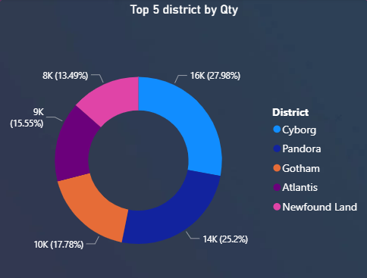
KPI Based on the district
Based on the insights their was a strong demand and market presence in CYBORG & PANDORA areas. You can emphasize the availability and popularity of your products in those districts
Product consumption was getting
reducing in Atlanties and Newfound Land

Slide 5
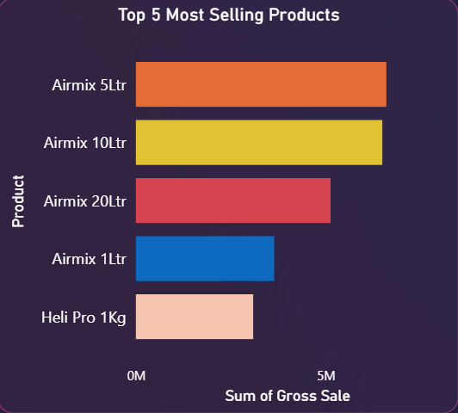
KPI Based on the Product
Airmix 5L, 10L, 20L, 1L, and 1kg cater to diverse customer requirements, ensuring we have the right product for every need.
Our top-selling Airmix Range offers versatile and reliable chemical solutions for various applications.
With options available in different sizes (5L, 10L, 20L, 1L, and 1kg), customers can choose the perfect fit for their needs.

Slide 6
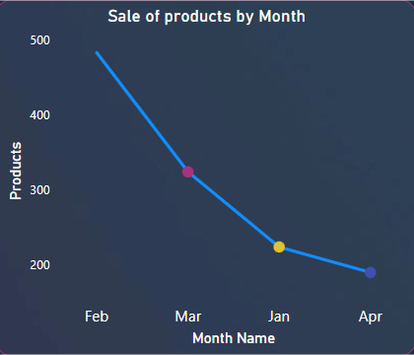
KPI Based on the Month
The insight shows that the seasonality trend of the sales
on Feb Month getting more sales so we have to plan the production based on that season
Where as on other months there was approx 30% reduction in the sales compare to Feb month data

Slide 7
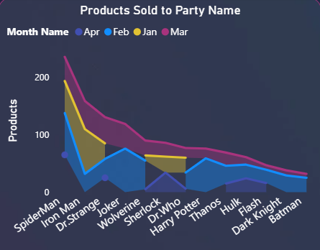
KPI Based on the Product Sold to Customer
The insight shows that the Decreasing trend
So we can choose the high-preference customer on this insight.
The discount allocation can be controlled with the help of this insights.

Slide 8

Conclusion
Insight Over View
The months of February and March demonstrate higher sales volume compared to April and January, indicating potential seasonal demand patterns.
To capitalize on the peak sales months, allocate additional resources and marketing efforts during these periods to maximize sales opportunities.
Identify the factors contributing to the success during these months, such as promotional campaigns, customer preferences, or market trends, and leverage them to drive sales throughout the year.
Consider conducting market research or customer surveys to gain deeper insights into the reasons behind the increased sales during these months, allowing for targeted strategies and product offerings.
Continuously monitor and analyze sales trends to identify emerging patterns and adapt business strategies accordingly, ensuring sustained growth and profitability throughout the year.

